Slide 1
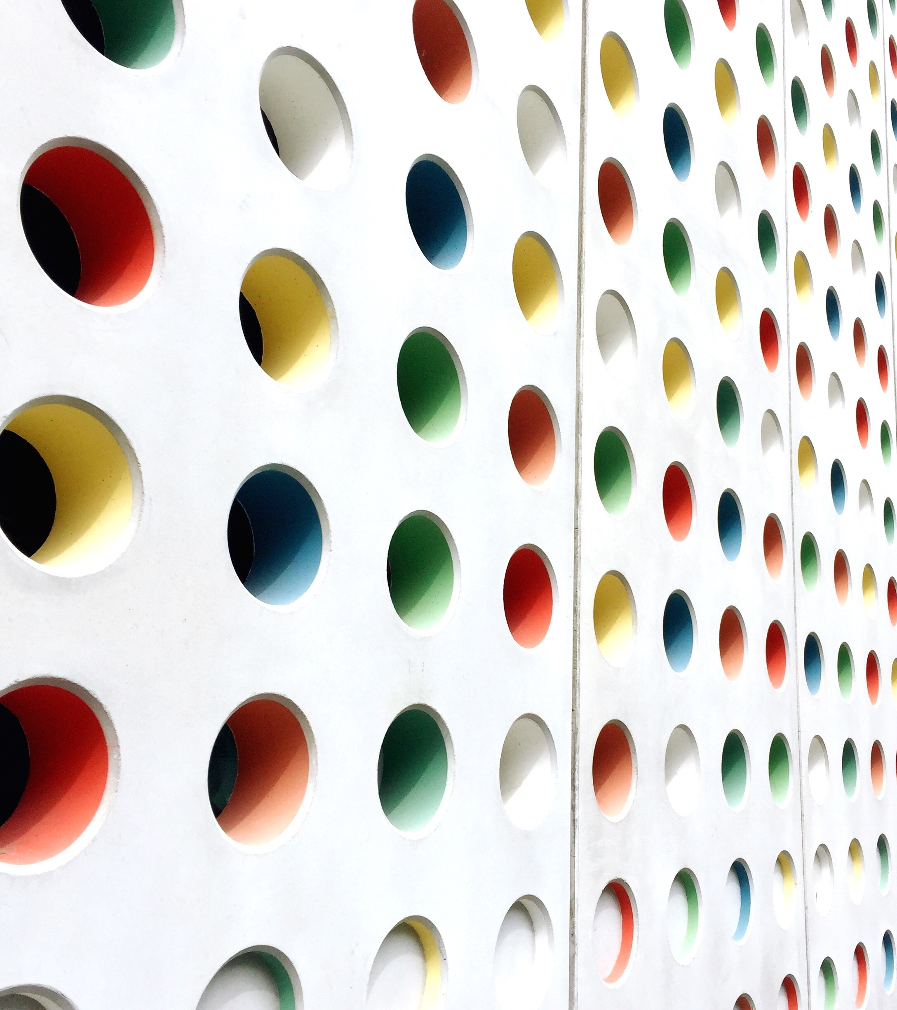
Hoffman Project
George Needham

Slide 2
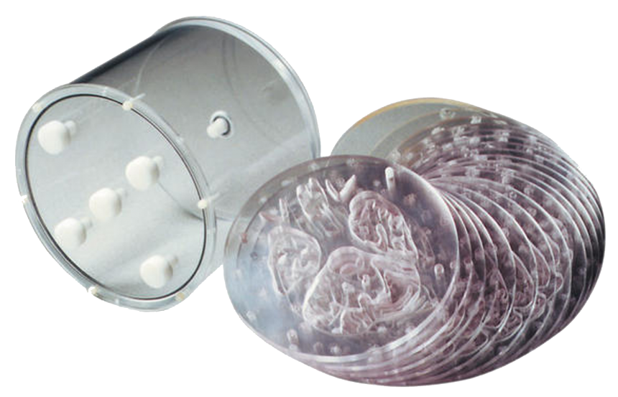
Hoffman Phantom
“3D” version of phantom designed to mimic a typical brain for isotope imaging (SPECT & PET)
White:Grey matter replicated in “typical” 1:4 ratio
19 independent fillable plates, then stacked into cylinder
Each of 19 plates composed of 5 inner “slices” (each containing two thin slices, 0.75mm thick) – 180 slice resolution of brain
Optional skull insert
Cylinder dimensions: 17.5cm depth x 20.8cm diameter
Sourced from www.southernscientific.co.uk/

Slide 3
Standardisation Exercise
2013 study overseen by Dr Heather Williams at The Christie
18 Centres involved:
Aberdeen, Belfast, Cambridge, Cardiff, The Christie (Manchester), Dundee, Edinburgh, Glasgow, Leeds, Manchester Central, Newcastle, North Staffordshire, Oxford, Royal Surrey, Sheffield, St. Thomas (London), UCL/UCLH (London), WMIC (Manchester)
Each centre tasked with scanning the Hoffman phantom filled with ~50 MBq of FDG
Data reconstructed using a standardised protocol and each centre’s own clinical protocol
Standardised protocols slightly different depending on scanner manufacturer

Slide 4
Standardised Protocol
Parameter | GE | Siemens | Philips
Reconstruction Algorithm | 3D Iterative, 3 iterations, 20 subsets (3i20s) | 3D OSEM, 3i21s | 3D Iterative, 3i20s
FoV | 250mm | 253.4mm | 256mm
Pixel Size | 1.95mm | 1.97985mm | 2mm
Post-Recon Filter | Gaussian, 4mm FWHM | Gaussian, 4mm FWHM | Relax 1
Identical parameters include: Scatter Correction – on; Attenuation Correction – CTAC; Randoms Correction – on; Image Matrix – 128x128; List Mode Acquisition – 30 mins, unlisted at 6x5 mins

Slide 5
Centre Information
Centre | Scanner Manufacturer | Scanner Model
Aberdeen | GE | Discovery 710
Belfast | GE | Discovery 690
Cambridge | GE | Discovery 690
Cardiff | GE | Discovery 690
Christie | GE | Discovery STE8
Dundee | Siemens | Biograph mCT
Edinburgh | Siemens | Biograph mCT
Glasgow | GE | Discovery 690
Leeds | GE | Discovery 690
Centre | Scanner Manufacturer | Scanner Model
Manchester C | Siemens | mCT (SOMATOM?)
Newcastle | Siemens | Biograph mCT
N. Staffs. | Siemens | Biograph mCT
Oxford | N/A | N/A
Royal Surrey | Siemens | mCT
Sheffield | Philips | Gemini TF 64
St. Thomas | GE | Discovery 710
UCL/UCLH | GE (2) | Discovery ST/VCT
WMIC | Siemens (2) | mCT/HRRT

Slide 6
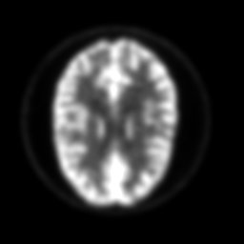

Work So Far 19/01/2023
Images resliced and registered according to model FDG OSEM brain scan
Images aligned and images converted & cleaned from DICOM to Analyze in ImageJ
SPM (Statistical Parametric Mapping) program developed by
New matrix 91x109x91
Pre- and post-registration & reslicing (Cardiff, standard protocol, central slice)

Slide 7
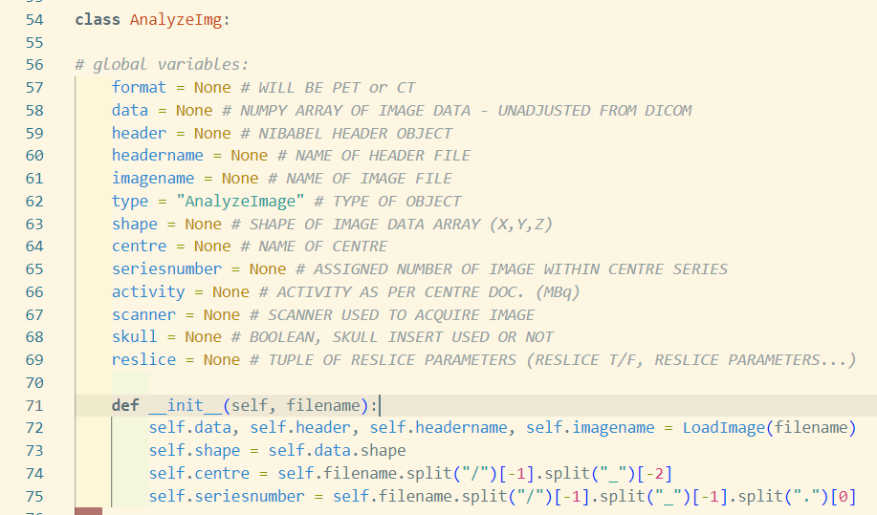

Work So Far 26/01/2023
Changing tack to an object-oriented approach, collating all information in one place
image data
resliced/normalised image data
metadata (DICOM header info, acquisition & centre info)
Image masking – “GM” and “WM” masks created from thresholding WM & GM to 40% of max, subtracting overlapping voxels

Slide 8
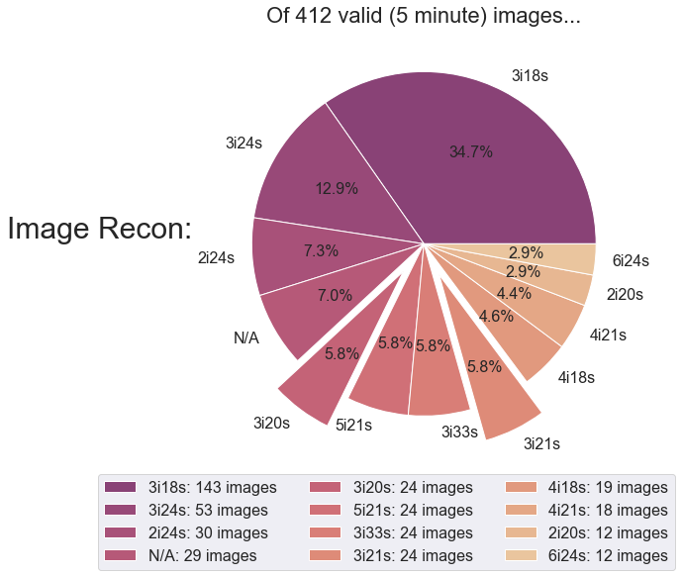
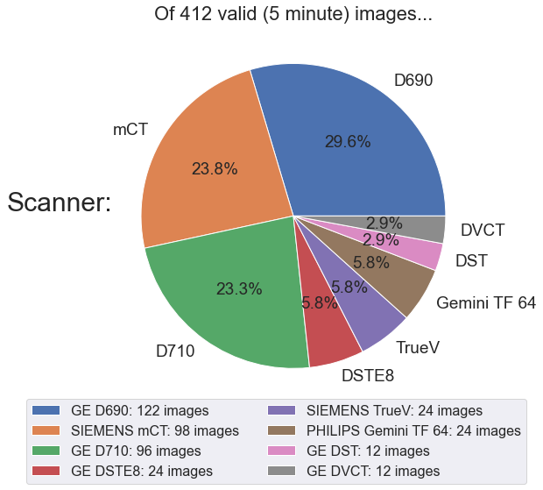
Update 16/02/2023 (1)
Laying out the dataset…
Requested “standardisation” parameters

Slide 9
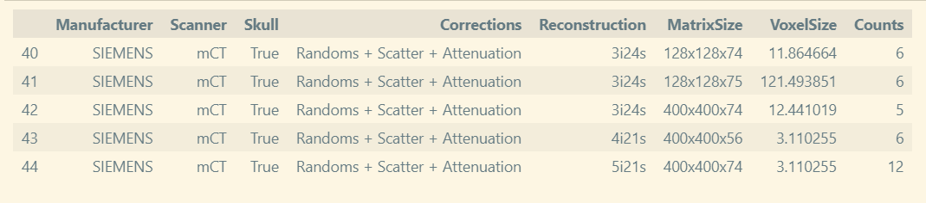
Update 16/02/2023 (2)
Laying out the dataset…
45 distinct “categories” of image (omitting PSF for now – more anon).
Some of these categories are multi-centre (i.e. more than one centre matches these parameters).
(“frequency”)

Slide 10
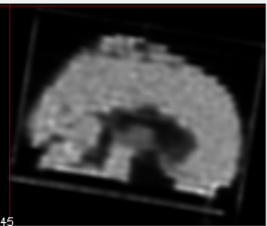
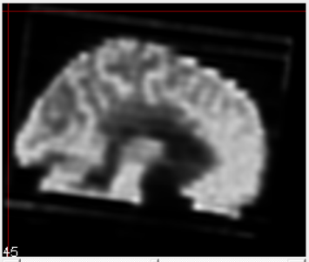
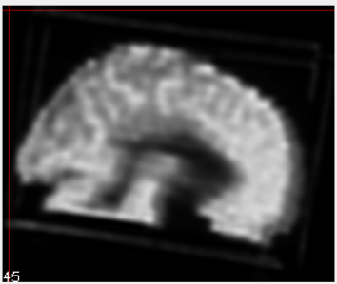
Update 16/02/2023 (3)
Why does this matter?
Rigid registration of PET images to independent FDG PET template reference is imperfect. Take two same-category datasets, one from Royal Surrey & one from North Staffs. Create average image of each over 6 frames (A&B), then average those two resultant images together (C):
A
B
C

Slide 11
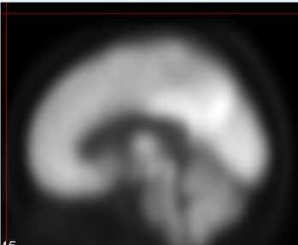
Update 16/02/2023 (4)
This is likely a multifaceted problem, due to artefacts at the edges of the phantom cylinder, nonuniform phantom filling (differently-located air bubbles) and crucially the difference between the phantom and the reference target (D).
Possible solutions:
Work with a Hoffman phantom as registration target – but what to choose as target? No uniform, idealised version in dataset.
Create a “Hoffman-esque” version of D using non-rigid, warping registration.
A
D

Slide 12
Update 16/02/2023 (5)
Crucial problem is due to ROI definition. Uneven filling of the phantom means that use of a standard ROI across all images, even when registered, will be biased by air bubbles. This requires definition of custom ROIs for each acquisition/reconstruction (~68).
To automate, easily enough done through CT. BUT this requires CT registration too!
CT is already registered to partner PET scans. CT ROIs easily defined (~5-50 WM, ~50-100 for GM) and can account for air bubbles.
Initial attempts underway to do ROI definition on CT without registration, but not the ideal situation
Meanwhile, attempting to make a more convincing template with non-rigid registration.

